Slide 1
Abdominal cavity and peritoneum
Dr Anjali Prasad
Assistant Professor
Anatomy Department
Sri Krishna Medical College
Muzaffarpur (Bihar)

Slide 2
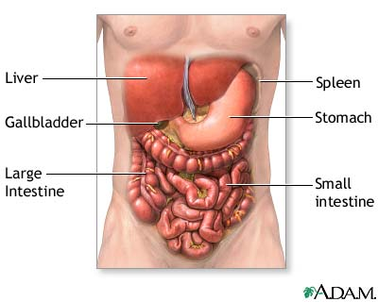
Abdomen
Abdominal cavity – largest cavity of the body.
Abdominal cavity is subdivided by the plane of pelvic inlet into upper part, the abdomen proper, & a lower part pelvic cavity
Contents
GI tract & acompany
Urogenital system
Blood vessels, lymphatics & nerves

Slide 3
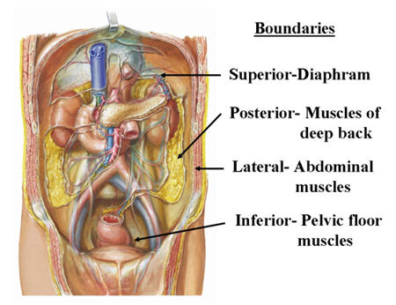
Boundaries of abdominal cavity
Roof – Undersurface of the diaphragm
Floor – Absent inferiorly as the abdominal cavity communicate with the pelvic cavity
Ant. wall – Musculo-fibrous
Lateral wall/flank - Muscular
Post. wall – Osseo-musculofascial

Slide 4
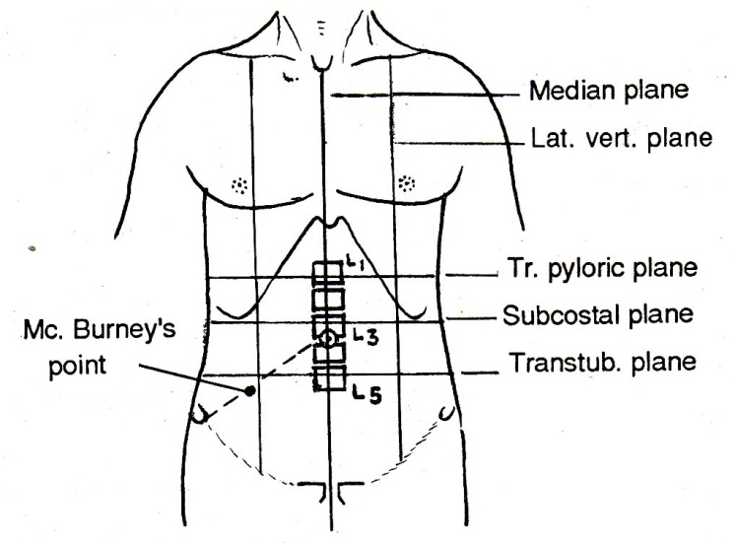
Division of abdominal cavity

Slide 5
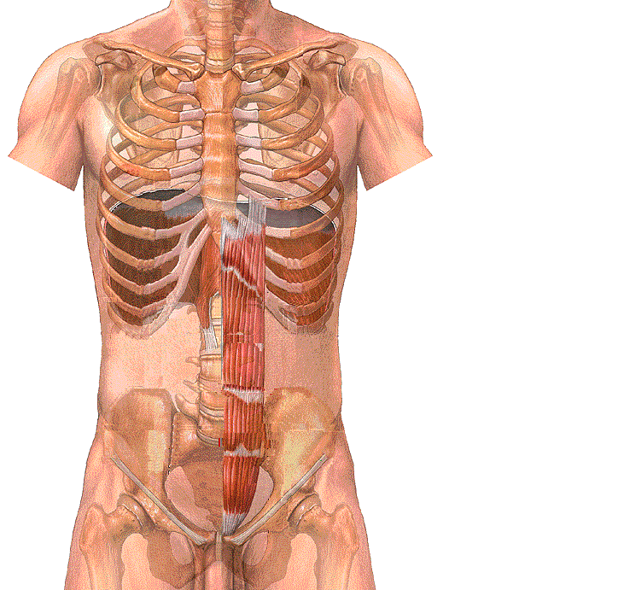
The transpyloric plane
It is a transverse line drawn
midway between
The suprasternal notch
& The symphysis pubis
The subcostal plane
It is a transverse line drawn between
the lowest points of the costal margin
The transumbilical plane
It is a transverse line that passes thru umbilicus
The intertubercular plane
a transverse line drawn between
the 2 tubercles of the2 iliac crests
The 2 lateral vertical planes
A vertical line drawn from
the midclavicular point
The body planes
to the midinguinal point

Slide 6
The anterior abdominal wall
is divided into
9 regions by
2 transverse lines
The transpyloric plane L1
&The intertubercular plane L5
The Rt. & Lt.
lateral vertical planes
and 2 vertical line
divisions of the abdomen

Slide 7
The 9 regions are
3 in the middle
From above downward
Epigastrium
Umbilical
Hypogastrium
3 on the right side & 3 on the left side
From above downward
Rt. & Lt. Hypochondrium
Rt. & Lt. Lumbar region
Rt. & Lt. Iliac region
Divisions of the abdomen

Slide 8
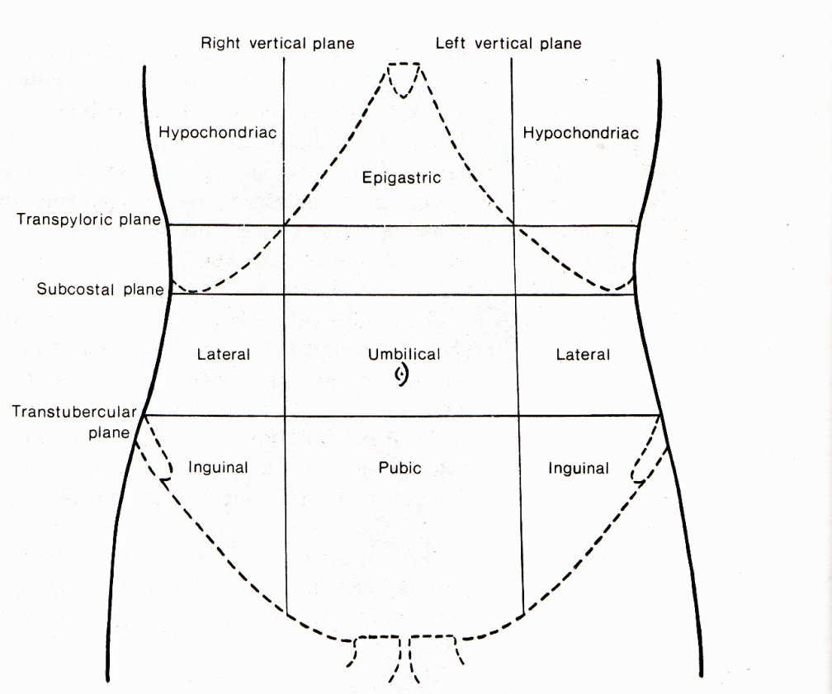
Regions of abdomen
(Rt. lumbar)
(Lt. lumbar)
(Rt. iliac)
(Hypogastric)
(Lt. iliac)

Slide 9
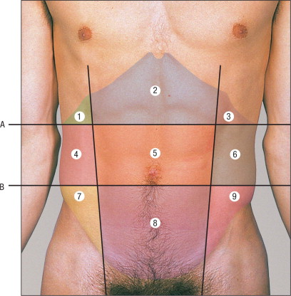

Slide 10
Peritoneum

Slide 11
Peritoneum
It is the largest serous membrane which lines abdominal cavity & reflected over the viscera
It invest viscera partially or completely
It divided into parietal & visceral layers, which are separated by a potential space & filled with the capillary layer of fluid
In male peritoneal cavity is closed sac, whereas in female it forms an open sac as it communicates with the exterior thru reproductive tract.

Slide 12
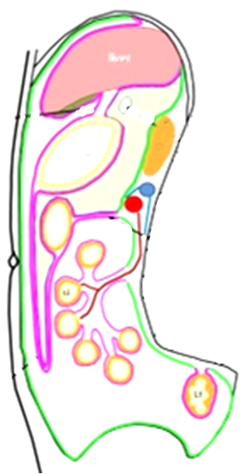
Parietal peritoneum
It is developed from somatopleuric layer of lateral plate mesoderm
It is supplied by somatic vessels & nerve
It is sensitive to pain & receive all modalities of cutaneous sensations.

Slide 13
Visceral peritoneum
It is developed from splanchnopleuric layer of lateral plate mesoderm
It is supplied by visceral vessel & autonomic nerves
It is insensitive to pain, tactile & thermal sensations.

Slide 14
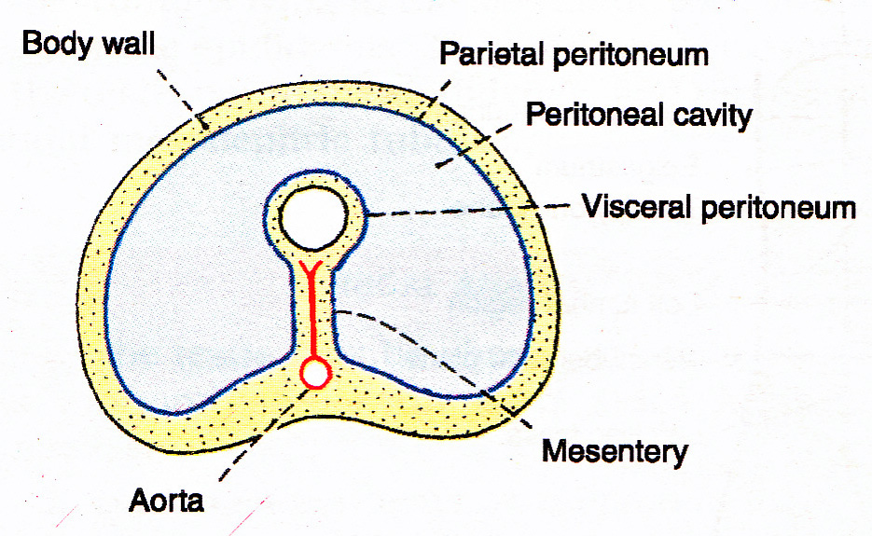
Peritoneum.

Slide 15
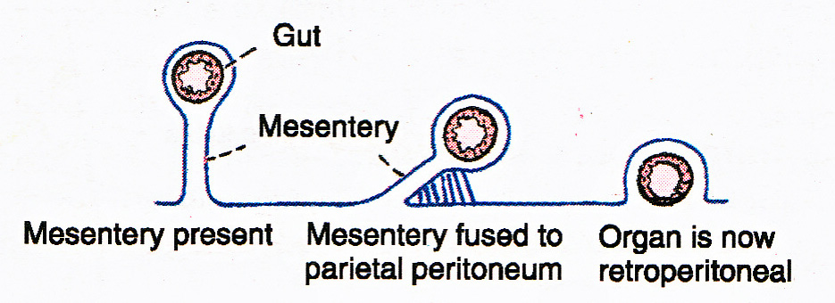
Zygosis

Slide 16
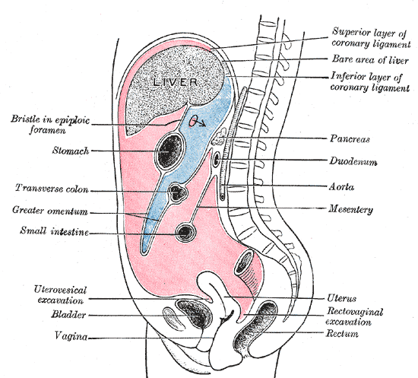
Peritoneal cavity
Viscera fill the peritoneal cavity completely, so cavity is reduced to a potential space separating adjacent layer of peritoneum
It is divided mainly two parts, large part is greater sac & small part , situated behind the stomach, lesser omentum & liver is called lesser sac
Two sac communicate with each other through Epiploic foramen/foramen of Winslow.

Slide 17
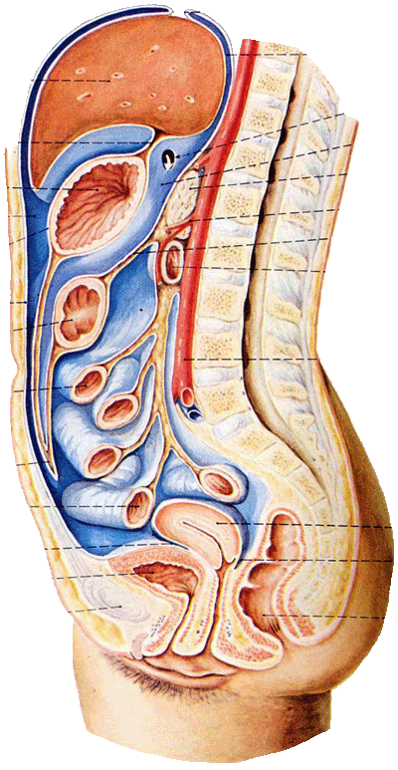
Peritoneal folds
Small intestine – Mesentery
Colon – Mesocolon
Stomach – Omentum (cover)
Double fold – Ligament

Slide 18
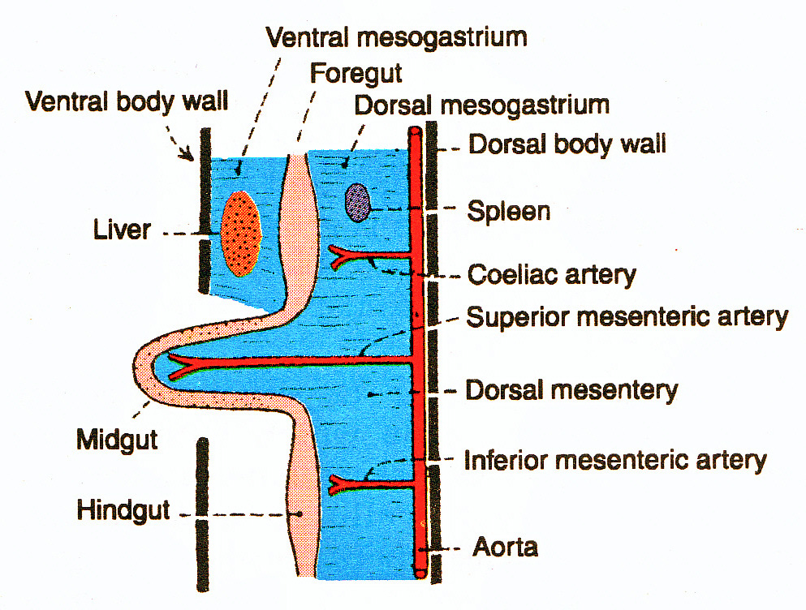
Peritoneal folds

Slide 19
Ligaments

Slide 20
Folds of peritoneum

Slide 21
Functions of peritoneum
Movements of viscera
Protection of viscera
Absorption & dialysis
Healing power & adhesions
Storage of fat (Appendices epiploicae)
Pathway for passage of vessels, nerves and lymphatics.
Transfer of oocyte takes place thru peritoneal cavity after ovulation.

Slide 22
Horizontal & vertical disposition of peritoneum

Slide 23
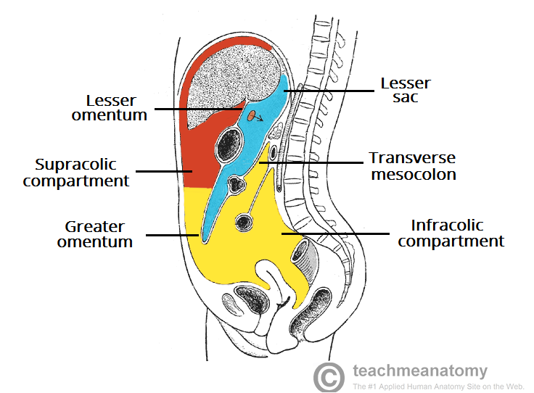
Greater sac extends from diaphragm to pelvic floor
Lesser sac/omental bursa is situated behind the stomach & extends beyond the stomach

Slide 24
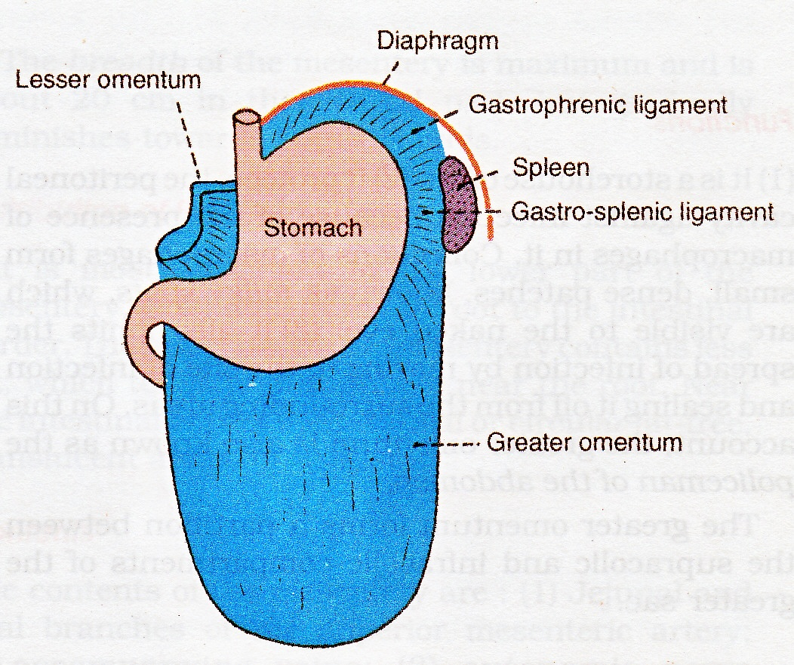
Greater omentum
Large fold of peritoneum, hangs down from greater curvature of stomach
Covers the loop of intestine
Made up of four layer of peritoneum, which are fused together & to form thin fenestrated membrane

Slide 25
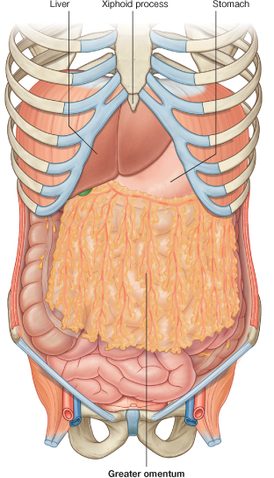

Slide 26
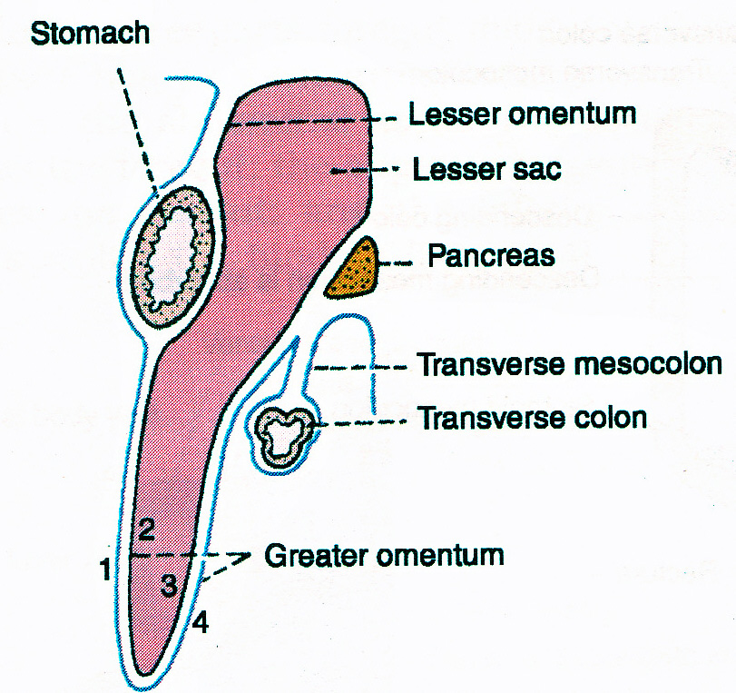
Greater omentum
Attachments – anterior two layers descend from gr. Curvature to a variable extent.
Contents – Rt. & Lt. gastroepiploic vessels & fat
Function – storehouse of fat, protection of cavity from infection k/a policeman of abdomen

Slide 27
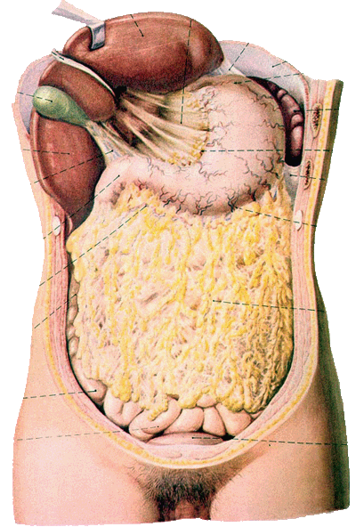
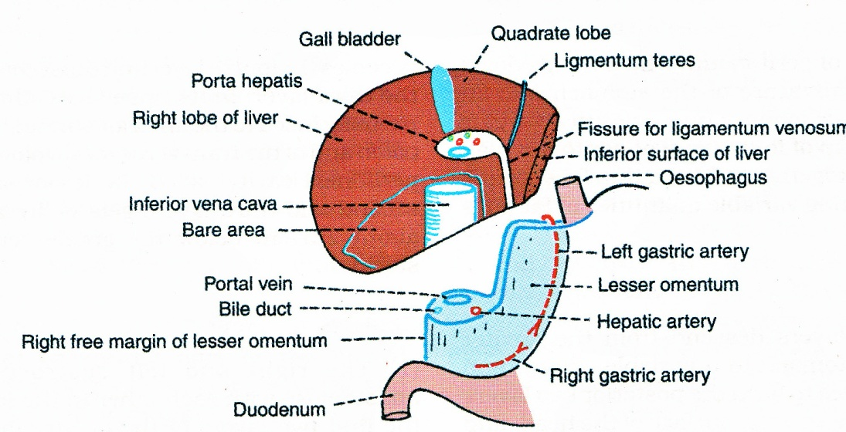
Lesser omentum
Extends from lesser curvature to liver .
Superiorly it attached to the liver in inverted “L’’ shape.

Slide 28
Lesser omentum.
Rt free margin of lesser omentum contains –: hepatic artery, portal vein, bile duct, lymph nodes & lymphatics & hepatic nerve plexus.
Along the lesser curvature -: Rt.& Lt. gastric vessels, lymph nodes & branches from gastric nerve.

Slide 29
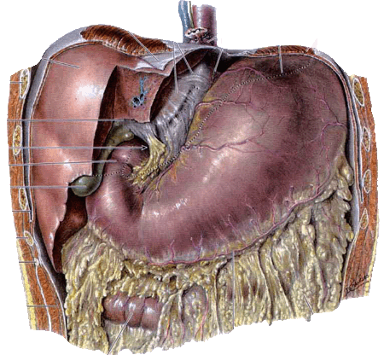
Epiploic foramen

Slide 30
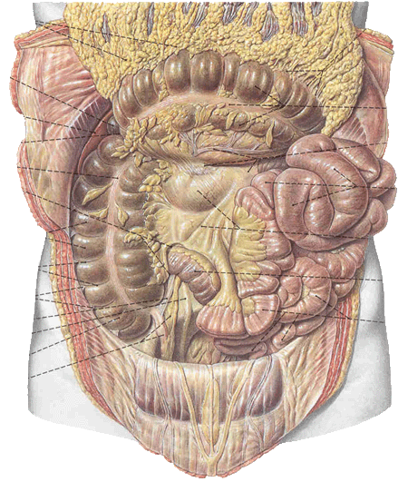
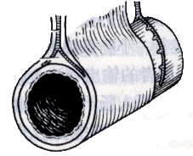
Structures which are formed by peritoneum
Mesentery

Slide 31
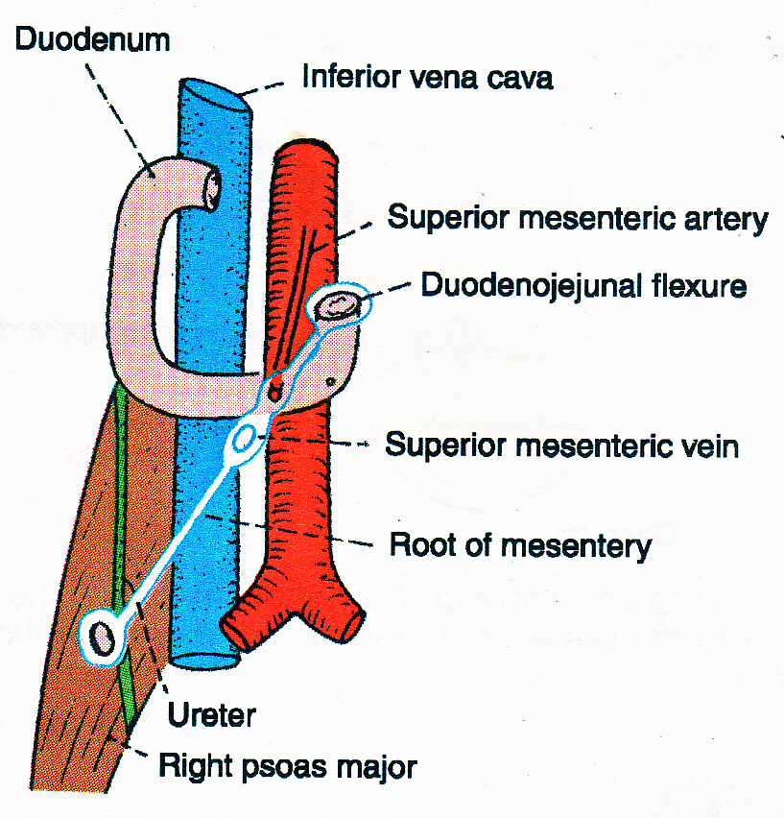
Mesentery.

Slide 32
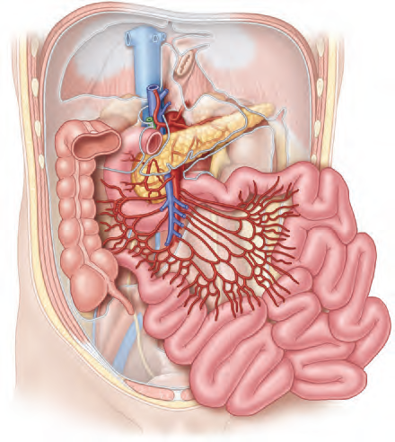
Structures which are formed by peritoneum

Slide 33
Mesoappendix.

Slide 34
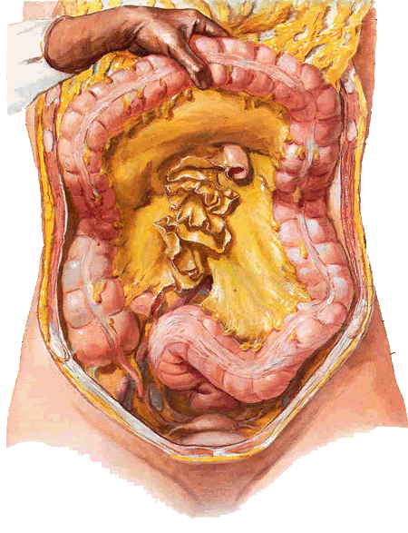
Structures which are formed by peritoneum
Transverse mesocolon
Sigmoid mesocolon

Slide 35
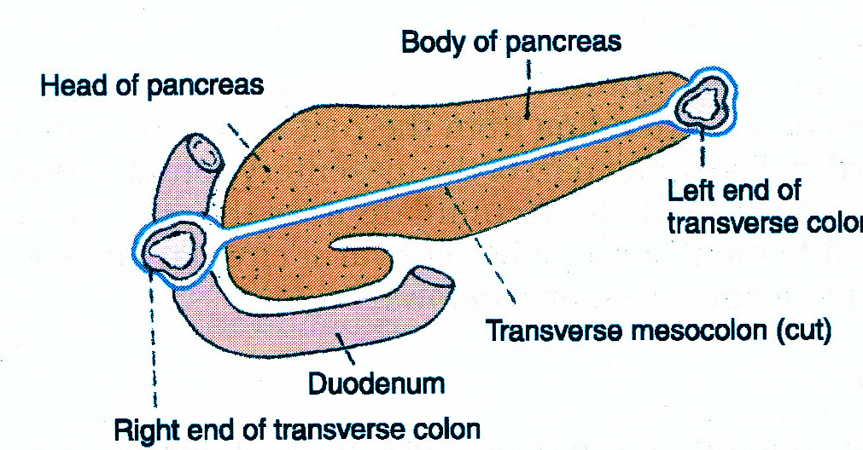
Transverse mesoclon

Slide 36
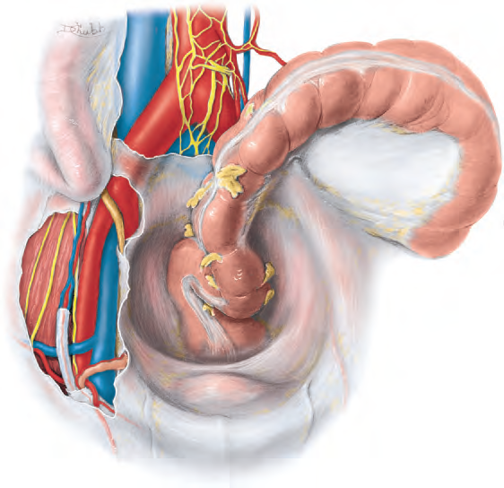
Structures which are formed by peritoneum
Sigmoid mesocolon

Slide 37
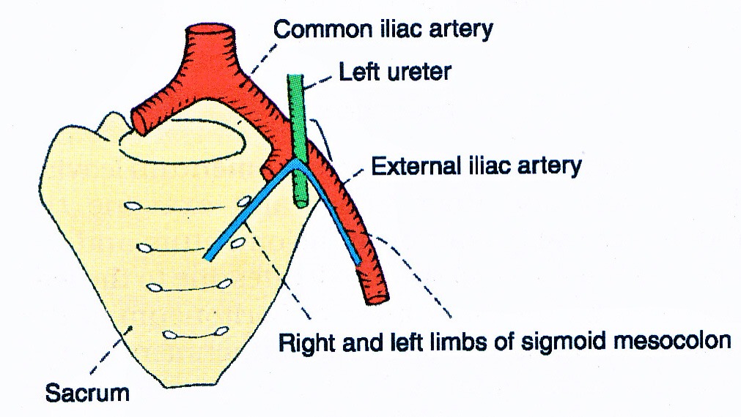
Sigmoid mesocolon.

Slide 38
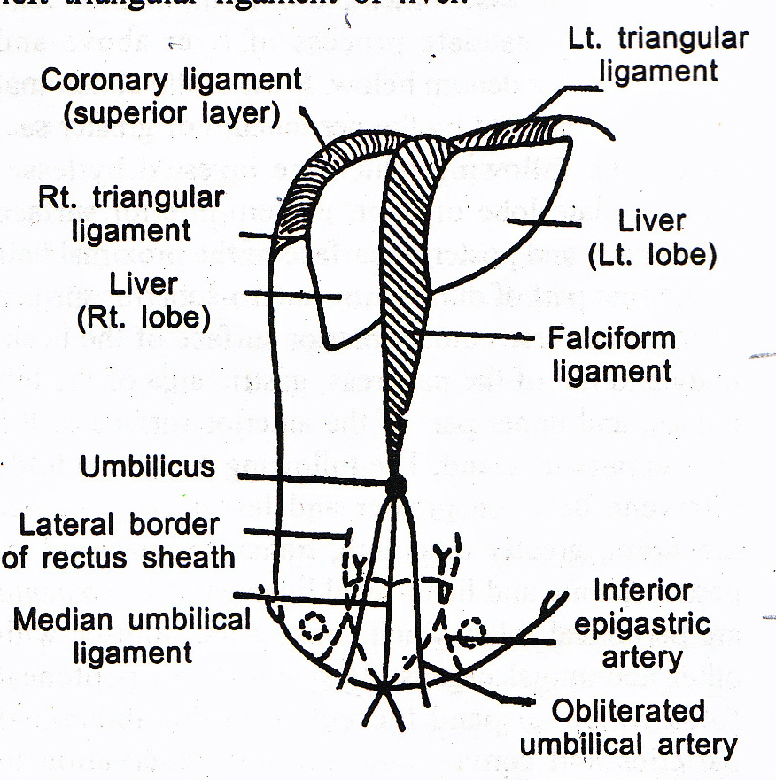
Vertical disposition.

Slide 39
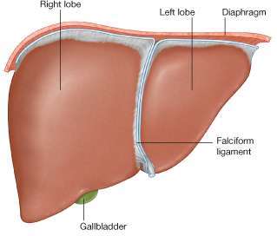

Slide 40
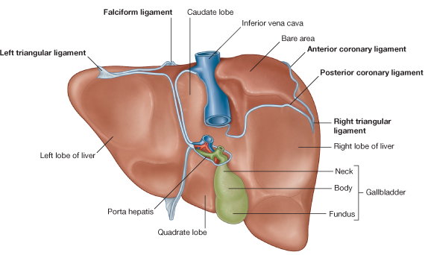

Slide 41
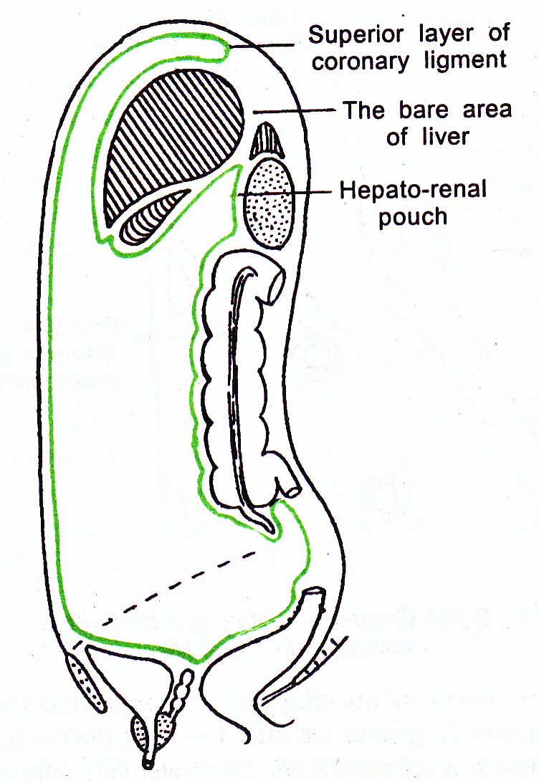
Vertical disposition
Inferior layer of coronary ligament, covers the part of anterior surface of right kidney, 2nd part of duodenum, right colic flexure & forms the Hepato-renal pouch of Morison

Slide 42
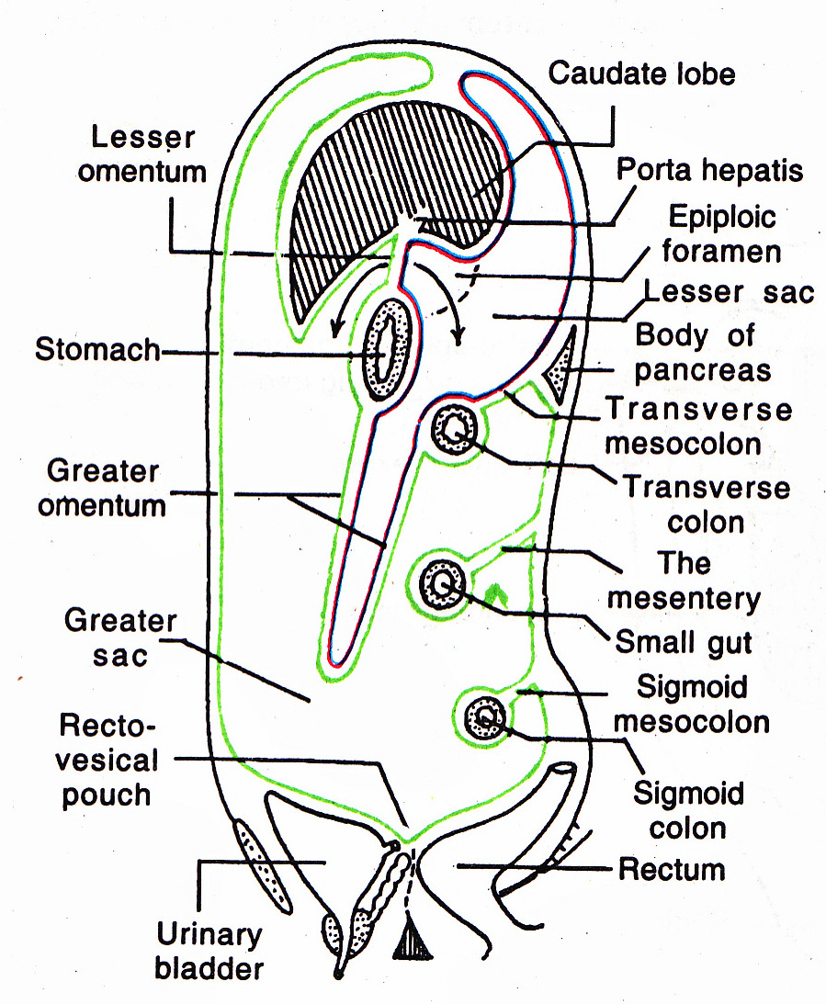
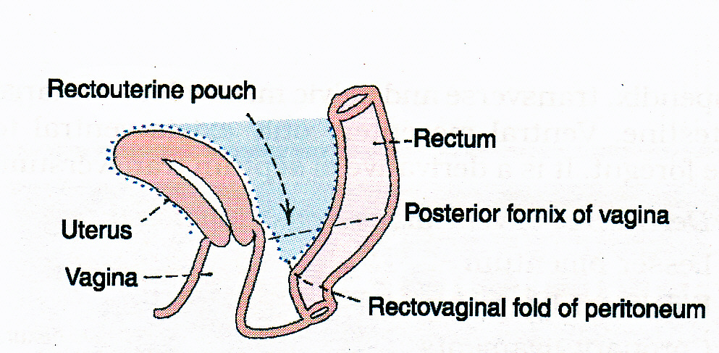
Vertical disposition

Slide 43
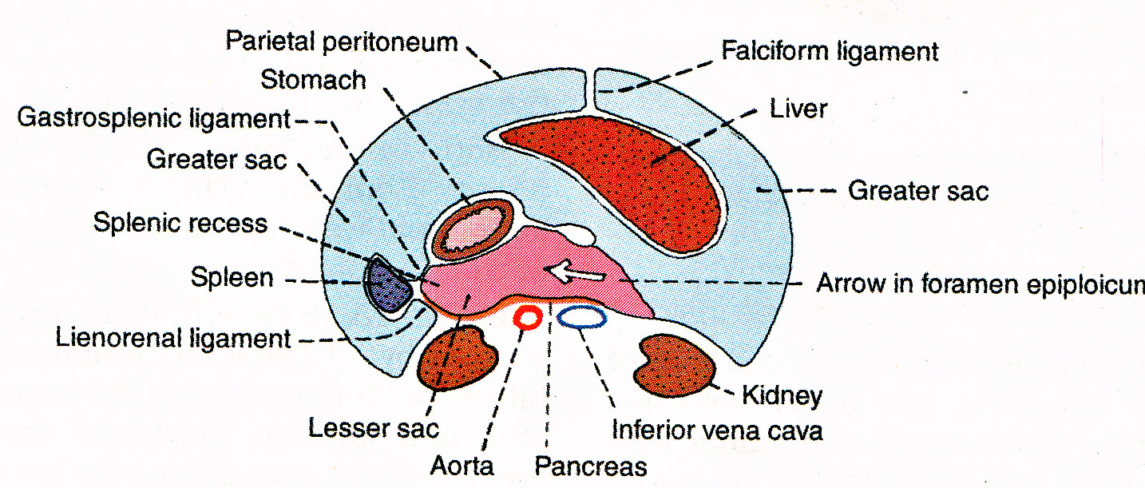
Horizontal disposition above level of transverse colon

Slide 44
Horizontal disposition below level of transverse colon

Slide 45
Omental bursa

Slide 46
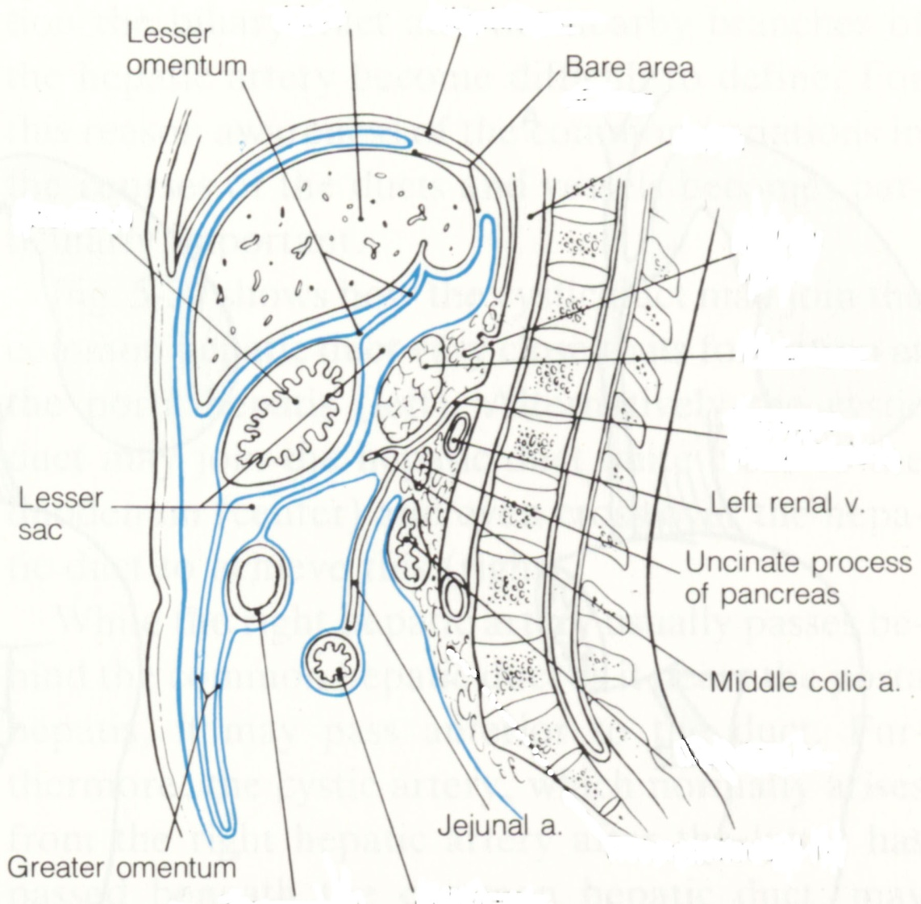
Lesser sac (omental bursa)
It is a diverticulum of peritoneal cavity.
It is situated behind the stomach & extends beyond the stomach
It acts as a bursa to allow expansion of stomach
It is closed on all side except at epiploic foramen through which communicate to greater sac

Slide 47
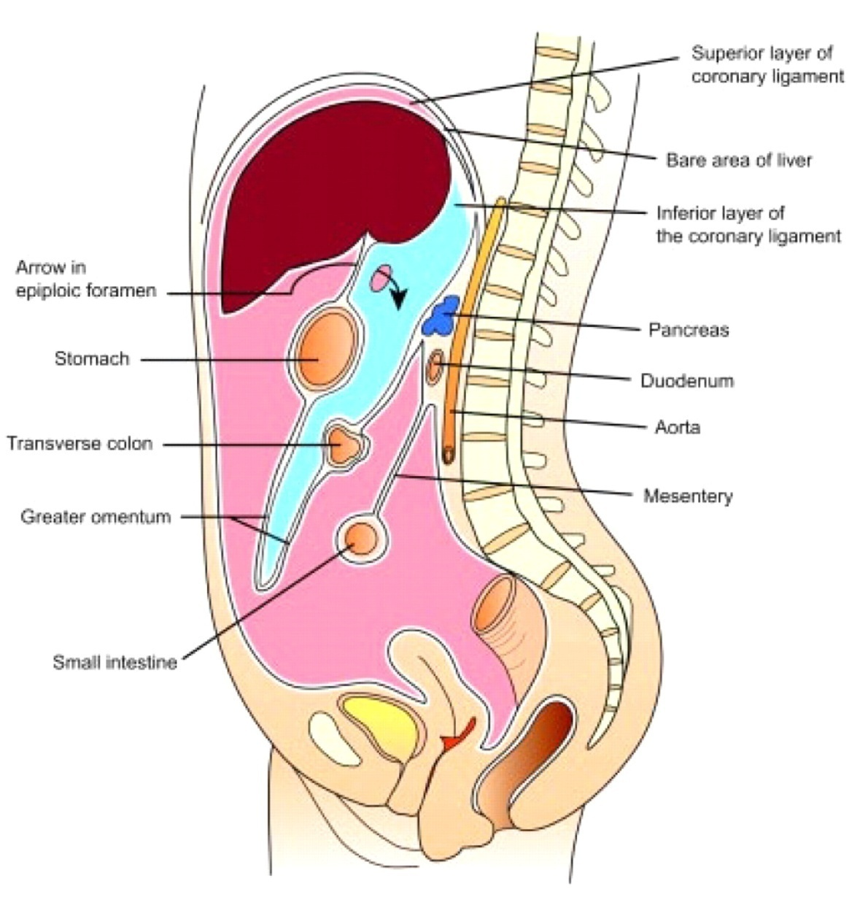
Lesser sac
Ant. wall -:
Post. wall -:

Slide 48
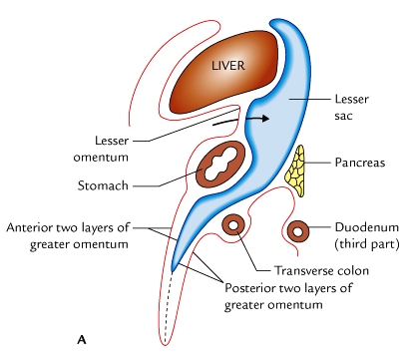
Recesses of the lesser sac
Lesser sac presents the following three recesses.

Slide 49
Epiploic foramen ( foramen of Winslow)
It is a vertical slit like opening through which lesser sac communicate with greater sac.
It is situated behind the right free margin of lesser omentum at the level of the 12th thoracic vertebra.

Slide 50
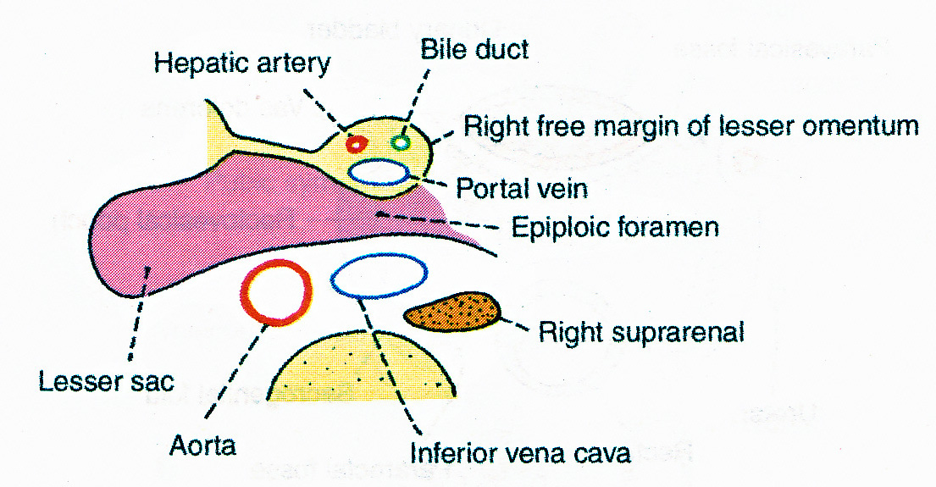
Epiploic foramen
Boundaries -:
Anteriorly -: Rt. free margin of lesser omentum containing portal vein, hepatic artery & bile duct.
Posteriorly -: IVC, Rt, suprarenal gland & 12th thoracic vertebra

Slide 51
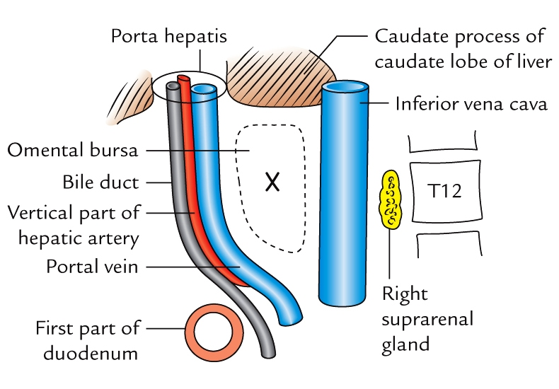
Epiploic foramen.
Boundaries -:
Superiorly -: Caudate lobe of the liver
Inferiorly -: First part of duodenum & horizontal part of hepatic artery

Slide 52
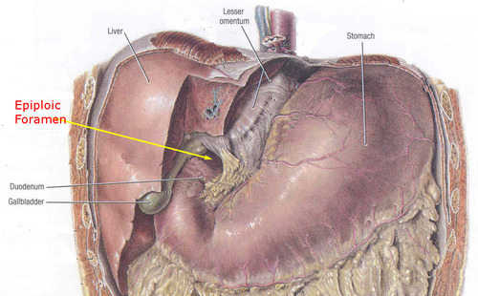

Slide 53
Applied anatomy
Internal hernia – sometimes the loop of small intestine may herniate into the lesser sac through epiploic foramen , producing internal hernia.

Slide 54
Pouch of douglas ( rectouterine pouch)
Pouch of peritoneum situated between the rectum and uterus.
Most dependent part of the peritoneal cavity in upright position.

Slide 55
Hepatorenal and rectouterine pouch

Slide 56
Clinical Anatomy
Excessive accumulation of fluid in the peritoneal cavity k/a ascities
Peritonitis – card-board rigidity
Pneumoperitoneum – due to perforation of stomach/intestine
Laparoscopy
Laparotomy

Slide 57
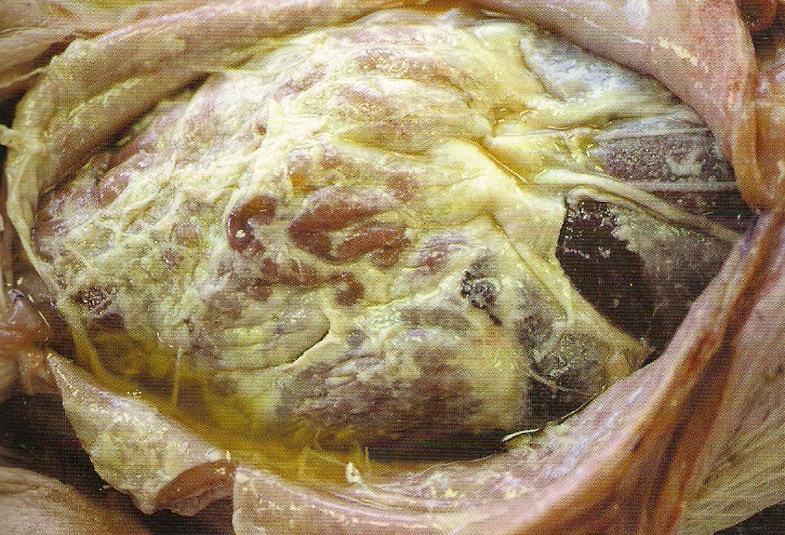
Peritonitis

Slide 58
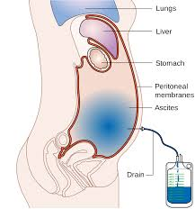
Peritoneal fluid
Abdominal paracentesis

Slide 59
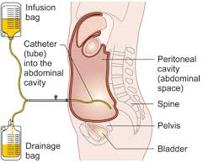
Peritoneal fluid
Peritoneal dialysis

Slide 60
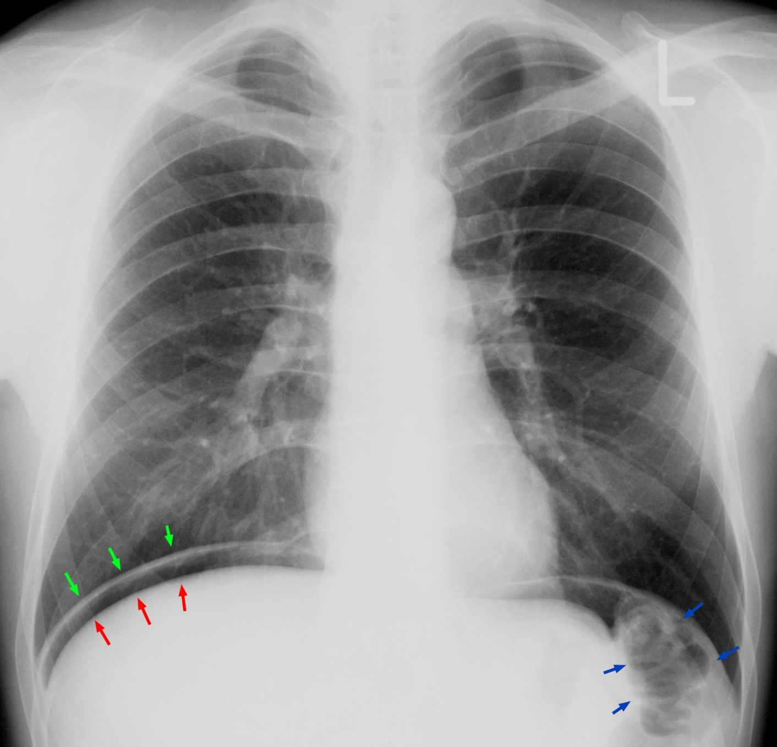
Pneumoperitoneum

Slide 61
Thank you

